Slide 1
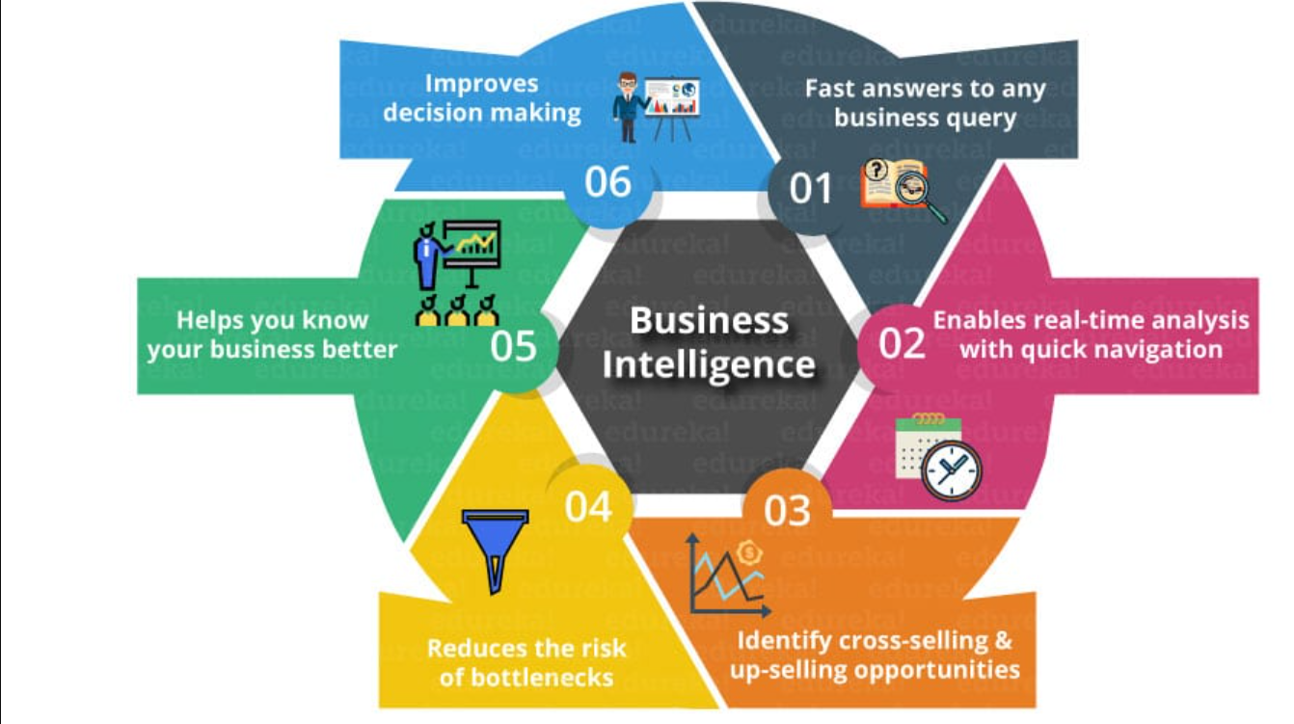
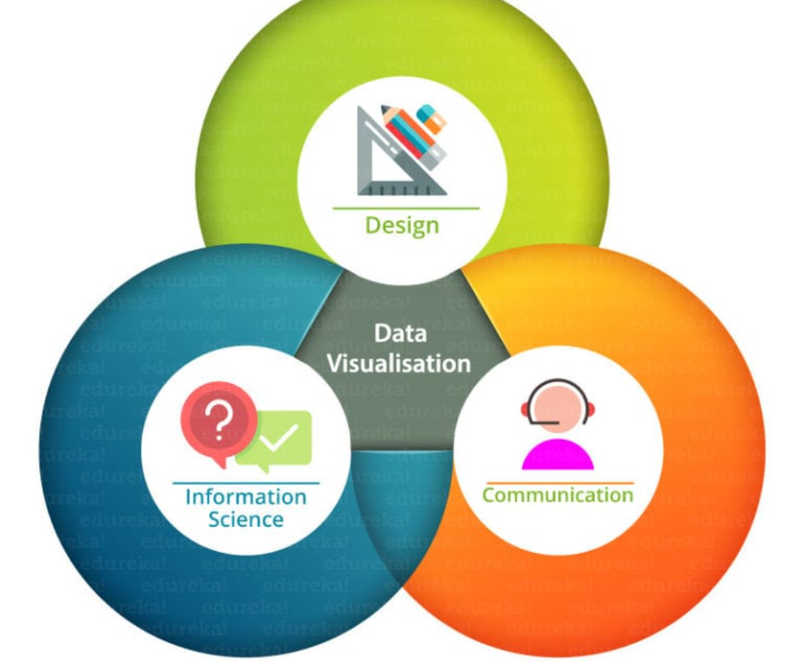
Abstract
Abstract
Introduction
Existing System
Proposed System
Architecture
Software & Hardware Requirements
Modules
Data Flow Diagrams/Algorithms/Techniques
References

Slide 2
Abstract
Abstract
Introduction
Existing System
Proposed System
Architecture
Software & Hardware Requirements
Modules
Data Flow Diagrams/Algorithms/Techniques
References
PowerBI is a visualization and robust of business analytics tools from Microsoft, which helps data professionals to bring their data to life and tells more meaning stores.
It is a powerful tool for sharing and communicating information.
For eg: In our day to day life, our business generates more data on sales revenue, marketing performance, customer interactions, costs etc. But with that much of data (which is in larger volume) it can be difficult for people to see the story it tells.

Slide 3
Abstract
Abstract
Introduction
Existing System
Proposed System
Architecture
Software & Hardware Requirements
References
So, here where the “Data Visualization” will comes, which helps you to turn all the data into easily understood, visually compelling, and useful for other business information.
Data visualization brings data to life, making you the master storyteller of the insights hidden within your numbers.
Through live data dashboards, interactive reports, charts, graphs, and other visual representations, data visualization helps users develop powerful business insight quickly and effectively.

Slide 4
Abstract
Introduction
Existing System
Proposed System
Architecture
Software & Hardware Requirements
References
Abstract
Introduction
Existing System
Proposed System
Software requirements
Architecture Model
Modules
UML Diagrams/ER Diagrams/Flow Charts
References
Introduction
PowerBI?
It is a Data Visualization and Business Intelligence tool that converts data from different data sources to interactive dashboards and BI reports.
Power BI suite provides multiple software, connector, and services - Power BI desktop, Power BI service based on Saas, and mobile Power BI apps available for different platforms. These set of services are used by business users to consume data and build BI reports.
Present Situations?
In the growing environment, time plays a major role. That if you lose some – it may raises many consequences.

Slide 5
Abstract
Introduction
Existing System
Proposed System
Architecture
Software & Hardware Requirements
References
Abstract
Introduction
Existing System
Proposed System
Software requirements
Architecture Model
Modules
UML Diagrams/ER Diagrams/Flow Charts
References
Introduction
For eg: Excess amount of data which is handled by an single person are often gives a late progress, cause of : they can’t handle that much volume of data and they can’t use any tools to visualize the present data in form of “graphs, charts etc.”
Also, sometimes we faces an scenario, that the data consists of many records and fields with same id but different conditions. So, for such scenarios we have developed this project.
In order to overcome from such scenarios at real-time – we are proposing this flutter-base applications, which gives the real time visualization of data on user interface screen to remote user and adds a fleet management console to admins, by making them manage and monitoring the visualization in R.T.

Slide 6
Abstract
Introduction
Existing System
Proposed System
Architecture
Software & Hardware Requirements
References
Abstract
Introduction
Existing System
Proposed System
Software requirements
Architecture Model
Modules
UML Diagrams/ER Diagrams/Flow Charts
References
Introduction
A good visualization tells a story, removing the noise from data and highlighting useful information.
Power BI desktop app is used to create reports, while Power BI Services (Software as a Service - SaaS) is used to publish the reports, and Power BI mobile app is used to view the reports and dashboards. These set of services are used by the business users to consume data and to build Power BI reports.
The BI term refers to Business Intelligence. It is a data-driven decision support system (DSS), which helps you to analyze the data and provide actionable information.

Slide 7
Abstract
Introduction
Existing System
Proposed System
Architecture
Software & Hardware Requirements
References
Abstract
Introduction
Existing System
Proposed System
Software requirements
Architecture Model
Modules
UML Diagrams/ER Diagrams/Flow Charts
References
Introduction
Power BI is a Data Visualization, and Business Intelligence tool which helps to converts data from different data sources into interactive dashboards and BI reports.
It also provides interactive visualization with self-service business intelligence capabilities where end users can create reports and dashboards by themselves without depending upon the staff members of IT sector.

Slide 8
Abstract
Introduction
Existing System
Proposed System
Architecture
Software & Hardware Requirements
References
Abstract
Introduction
Existing System
Proposed System
Software requirements
Architecture Model
Modules
UML Diagrams/ER Diagrams/Flow Charts
References
Introduction
Data Analysis : -
It is a technique used to analyze the data to enhance productivity and their business gains. Where the data is being collected from different resources and which is cleaned and analyzed to understand the pattern of it.
Data Analysis is important for organizations to understand their daily, weekly, monthly, or yearly sales or productivity.
Data Analysis is important for organizations to understand their daily, weekly, monthly, or yearly sales or productivity.

Slide 9
Introduction
Existing System
Proposed System
Software requirements
References
Abstract
Introduction
Existing System
Proposed System
Architecture
Software & Hardware Requirements
References
Existing System
LITERATURE SURVEY like “Power BI provides various tool sets and charts to analyze data efficiently. We will also use some of the basic techniques for data analysis in Power BI to generate valuable insights.”
The existing platform in visualization is for visualize the data is like to follow the fields which have unique identity of the dataset(Excel sheet) or in database(SQL), cause of we should maintain an unique names to make an proper relationships among the tables. And manually we can see the table names which consist of fields and records.
People have been visualizing data for a long time, but their ability to visualize large complex data sets quickly and easily is relatively new.

Slide 10
Introduction
Existing System
Proposed System
Software requirements
References
Abstract
Introduction
Existing System
Proposed System
Architecture
Software & Hardware Requirements
References
Existing System
The most game-changing tool for data visualization was Microsoft Excel, which was introduced less than 40 years ago.
Excel empowers people to work with data in unaggregated forms in rows and columns and then, with the click of a button, produce a visual representation of this data.
But the amount of data needed to be analyzed has continued to grow, and new tools have been created to handle it. These tools have the ability to handle larger data sets and offer a wider array of chart types.

Slide 11
Introduction
Existing System
Proposed System
Software requirements
References
Abstract
Introduction
Existing System
Proposed System
Architecture
Software & Hardware Requirements
References
Existing System
In our project we use an basic thing, which is known as SSRS (SQL Server Reporting Services). Which is a used as a reporting tool and developed by an Microsoft that comes free with MySQL server.
It produces formatted reports with the tables of data, graph, and reports. Reports are hosted on a server and can be configured to run by using parameters which is supplied by the users. When we run the reports, the current data appears from the database, XML file, or other data source.
It provides the security features that control who can see which reports.

Slide 12
Introduction
Existing System
Proposed System
Software requirements
References
Abstract
Introduction
Existing System
Proposed System
Architecture
Software & Hardware Requirements
References
Existing System
Disadvantages of Existing System:
Excel makes unstructured data a challenge : The challenge of analyzing real-time unstructured and semi-structured data in it. On the contrary, many new and upcoming data analytics tools can quickly recognize this type of data and create visualizations.
Excel can’t design interactive dashboards : A data visualization tool allows you to combine several types of charts to create interactive dashboards that display all of your KPIs in one place. You can create dashboards in Excel, but they are static, showing only high-level trends, and serve as a conclusion as opposed to a starting point for further exploration.

Slide 13
Introduction
Existing System
Proposed System
Software requirements
References
Abstract
Introduction
Existing System
Proposed System
Architecture
Software & Hardware Requirements
References
Existing System
Disadvantages of Existing System:
Excel doesn’t gives any updates in real-time : Data kept in Excel spreadsheets are stable. The moment you import a CSV file and build out a worksheet, data becomes out of date because it doesn’t connect to a live data warehouse.
Excel doesn’t give faster collaboration : Most Excel docs live locally. And while they do have cloud access, it’s really designed for individual use worksheets lacks comprehensive collaboration features. This results :- endless duplication of efforts and creates a mess from an organization perspective any time someone wants to build off of another person’s work.

Slide 14
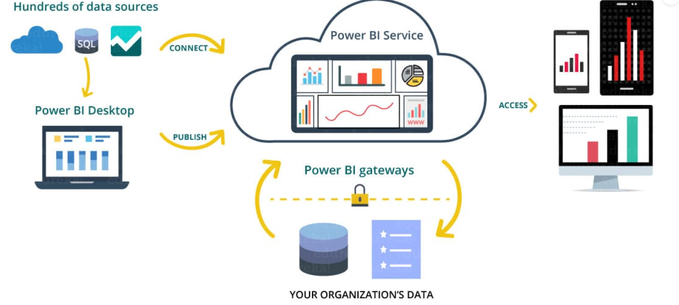
Introduction
Existing System
Proposed System
Software requirements
References
Abstract
Introduction
Existing System
Proposed System
Architecture
Software & Hardware Requirements
References
Proposed System

Slide 15
Introduction
Existing System
Proposed System
Software requirements
References
Abstract
Introduction
Existing System
Proposed System
Architecture
Software & Hardware Requirements
References
Proposed System
While data visualization tools have grown in power, they have also become more user-friendly.
Unfortunately there still remain gaps in people’s ability to use them due to a lack of data literacy.
Data literacy is the ability to read, understand, create, and communicate data as information.
Many data visualization tools do not provide the context needed to understand the underlying data.

Slide 16
Introduction
Existing System
Proposed System
Software requirements
References
Abstract
Introduction
Existing System
Proposed System
Architecture
Software & Hardware Requirements
References
Proposed System
Knowing how to best calculate metrics or represent the data requires education :
It allows real-time dashboard updates.
It provides secure and reliable connections to the data source in the cloud.
It allows data exploration using a natural language query.
PowerBI provides a hybrid configuration, quick deployment, and secure environment.
It provides features for dashboard visualization regularly updated with the community.

Slide 17
Introduction
Existing System
Proposed System
Software requirements
References
Abstract
Introduction
Existing System
Proposed System
Architecture
Software & Hardware Requirements
References
Proposed System
Advantages of Proposed System:
A quick start : You'll be able to get insights quickly with an uncomplicated setup, no required training, and included dashboards for services such as Salesforce, Google Analytics, and Microsoft Dynamics.
Streamlined publication and distribution : Instead of emailing large files or putting them on a shared drive, analysts upload reports and visualizations to the Power BI service, and their data is refreshed whenever the underlying dataset is updated.
Real-time Information : Any reports can be displayed and updated real-time data and visuals. Sources of streaming data can be factory sensors, social-media from which time-sensitive data is collected

Slide 18
Introduction
Existing System
Proposed System
Software requirements
References
Abstract
Introduction
Existing System
Proposed System
Architecture
Software & Hardware Requirements
References
Proposed System
Advantages of Proposed System:
Ability to customize PowerBI app navigation : An "app navigation experiences" feature gives report developers the power to customize navigation to help viewers find content quickly and understand the relationships between different reports and dashboards.
Ability to customize security features : Report developers can set up Row-Level Security (RLS) access filters to ensure that viewers see only data relevant to them, mitigating the risk of people seeing data they shouldn’t.
Artificial Intelligence : Users can access image recognition and text analytics, create machine learning models, and integrate with Azure Machine Learning.

Slide 19
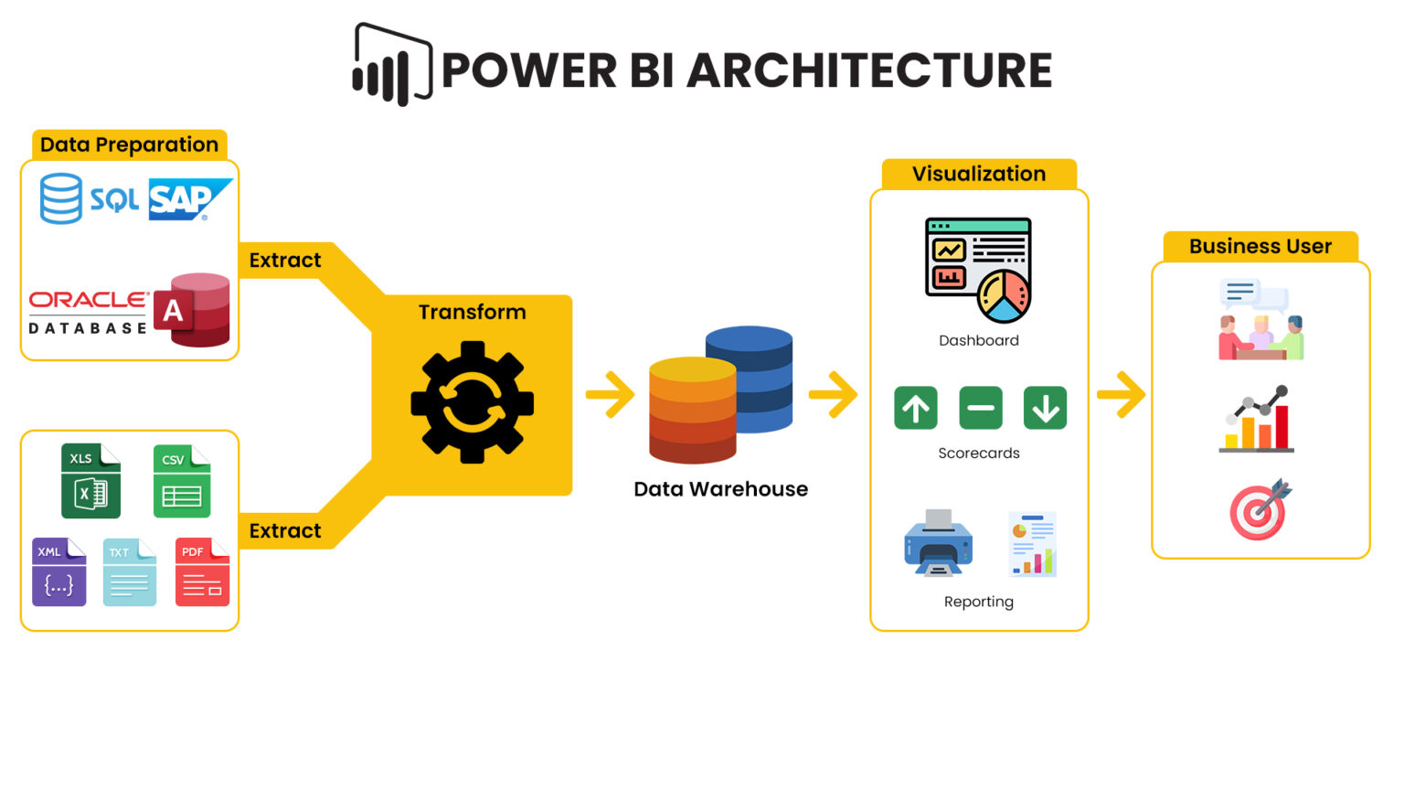
Architecture
Abstract
Introduction
Existing System
Proposed System
Architecture
Software & Hardware Requirements
References

Slide 20
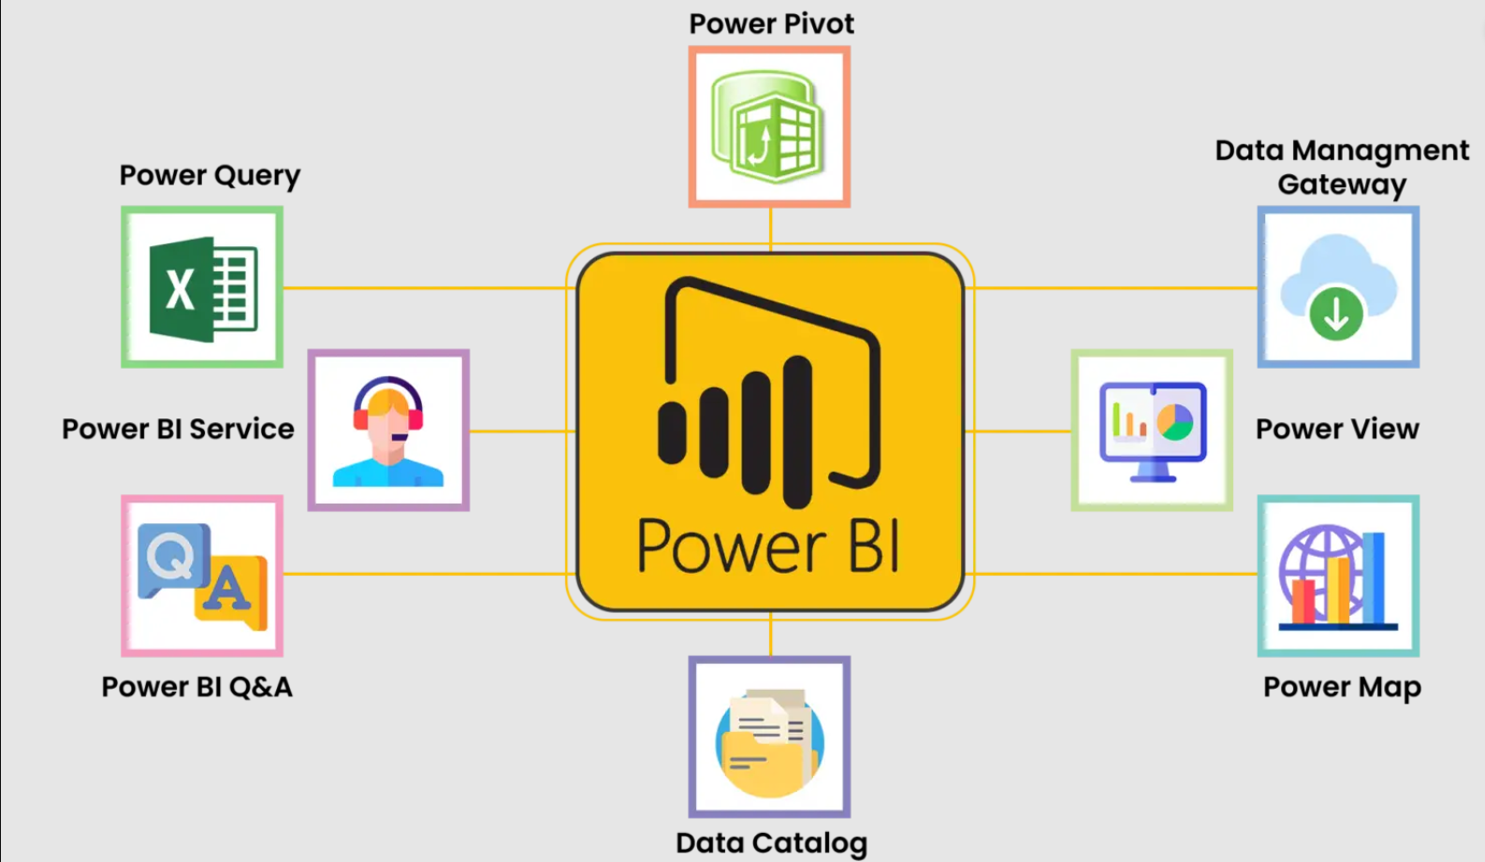
Architecture
Abstract
Introduction
Existing System
Proposed System
Architecture
Software & Hardware Requirements
References
Components of PowerBI :

Slide 21
Introduction
Existing System
Proposed System
Software Requirements
References
Abstract
Introduction
Existing System
Proposed System
Architecture
Software & Hardware Requirements
References
Software & Hardware Requirements
Hardware:
RAM: 4 GB or higher
Processor: Intel Core i3 or above
HDD:500GB minimum
Laptop/PC
DATASET:
We’ll be using a dataset as .CSV.
Software:
OS: Microsoft Windows or Linux
Python Shell: version 3.7 with ML packages.
Tool: Python IDLE, Anaconda
Language: Python

